Slide 1
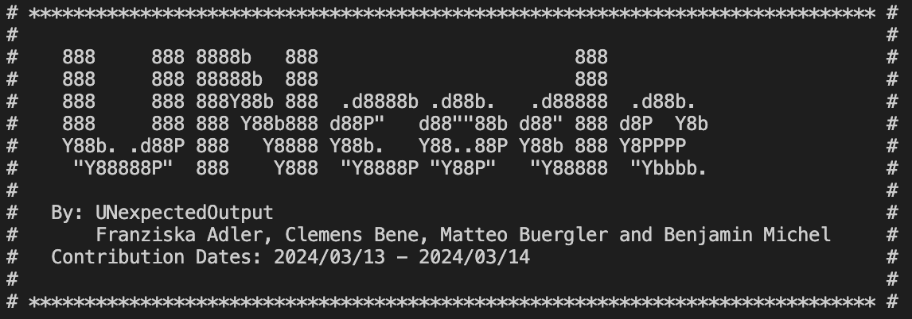

Slide 2
Problem definition
Background information
UNIDO is a specialized agency of the United Nations with a unique mandate to promote, dynamite and accelerate industrial development. UNIDO stands for United Nations Industrial Development Organization and works towards a world without poverty and hunger, where industry drives low-emission economies, improves living standards, and preserves the livable environment for present and future generations.
“Sustainable industrial development can deliver a world without hunger, using sustainable energy for productive activities, and creating jobs, particularly for young people.” – Gerd Müller, Director General of UNIDO
The challenge of the UNcode Hackathon is to develop an LLM-based solution leading to a comprehensive classification system for UNIDO’s project portfolio.
There are three main selection criteria to classify UNIDO’s projects by:
Firstly, UNIDO’s priorities, they reflect the organization’s strategic focus areas aimed at promoting industrial development in a sustainable and equitable manner
Secondly, UNIDO’s focus areas of expertise encompass the organization’s specialized knowledge and strategic approach towards fostering inclusive and sustainable industrial development (ISID)
Thirdly, the 17 Sustainable Development Goals (SDGs) are designed to be a “blueprint to achieve a better and more sustainable future for all” by 2030
By classifying UNIDO’s projects into these categories, UNIDO’s strategic programming can see a range of improvement, which will be further discussed later in this presentation.

Slide 3
Initial overview of model, outputs, and goals
Visualization
Modularity in software development involves breaking down a system into smaller, independent components, allowing for easier maintenance, testing, and scalability while promoting reusability and collaboration among developers.
User Interface
Modularity in software development involves breaking down a system into smaller, independent components, allowing for easier maintenance, testing, and scalability while promoting reusability and collaboration among developers.
Note of justification
Linking the invisible to the visible by providing an explanation of why the LLM came to its conclusion
Large-Language-Model (LLM)
A Large Language Model (LLM) is a sophisticated AI system adept at understanding and generating human-like text, employing deep learning to process extensive data for natural language tasks.
Modularity
Modularity involves breaking down a system into smaller, independent components, allowing for easier maintenance, testing, and scalability while promoting reusability and collaboration among developers..
Zero-shot-approach
Zero-shot learning involves training a model to recognize labels it has never seen before by teaching it to generalize from seen classes and apply that knowledge to unseen ones.
Generative AI
Generative AI creates new data resembling a given dataset. It generates content like images, text, or audio, often using techniques such as neural networks and probabilistic models.
Solution Automation
Modularity in software development involves breaking down a system into smaller, independent components, allowing for easier maintenance, testing, and scalability while promoting reusability and collaboration among developers.

Slide 4

Agenda
1
2
3
4
5
6
Input
Data & Extraction
Settings
Summarization
Classification
Outputs

Slide 5




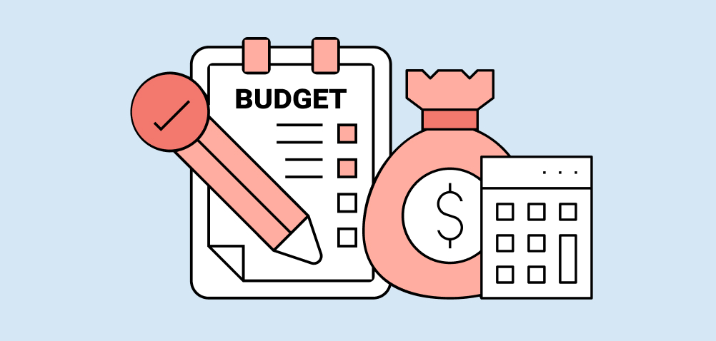

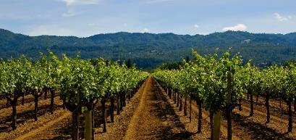
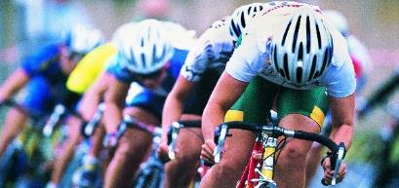
1. Input Approach
Subhead saw sea without
Chose a Category to select an input
Here are a few Examples
ID
Country Code
Budget
Days
Project ID
Country
Budget
Time
Choose to classify projects selected via their Project ID
Go to the folder src and launch
python main_proj_id.py
Choose to classify projects selected via their Country Code
Go to the folder src and launch
python main_filter.py
Choose to classify projects selected via their Budget
Go to the folder src and launch
python main_filter.py
Choose to classify projects selected via their Time in Days
Go to the folder src and launch
python main_filter.py

Slide 6
2. Data & Extraction
Dataset
Documents
API
Step 1
1
2
Step 2
3
OR
Extraction of Key Takeaways
Project ID
URL (for PDF of Project)
Time
Money
Budget
...
Downloading PDFs temporarily
Extraction from a PDF
Extraction of PDF Data
Converting Data into String
Repeat for all accessible PDFs related to a project
If 1 & 2 do not provide sufficient data, Project Data is gathered through an API Endpoint https://open.unido.org/api

Slide 7
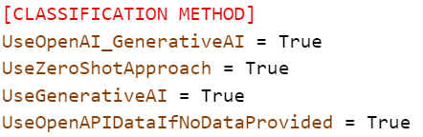
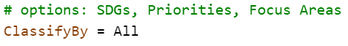
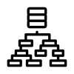
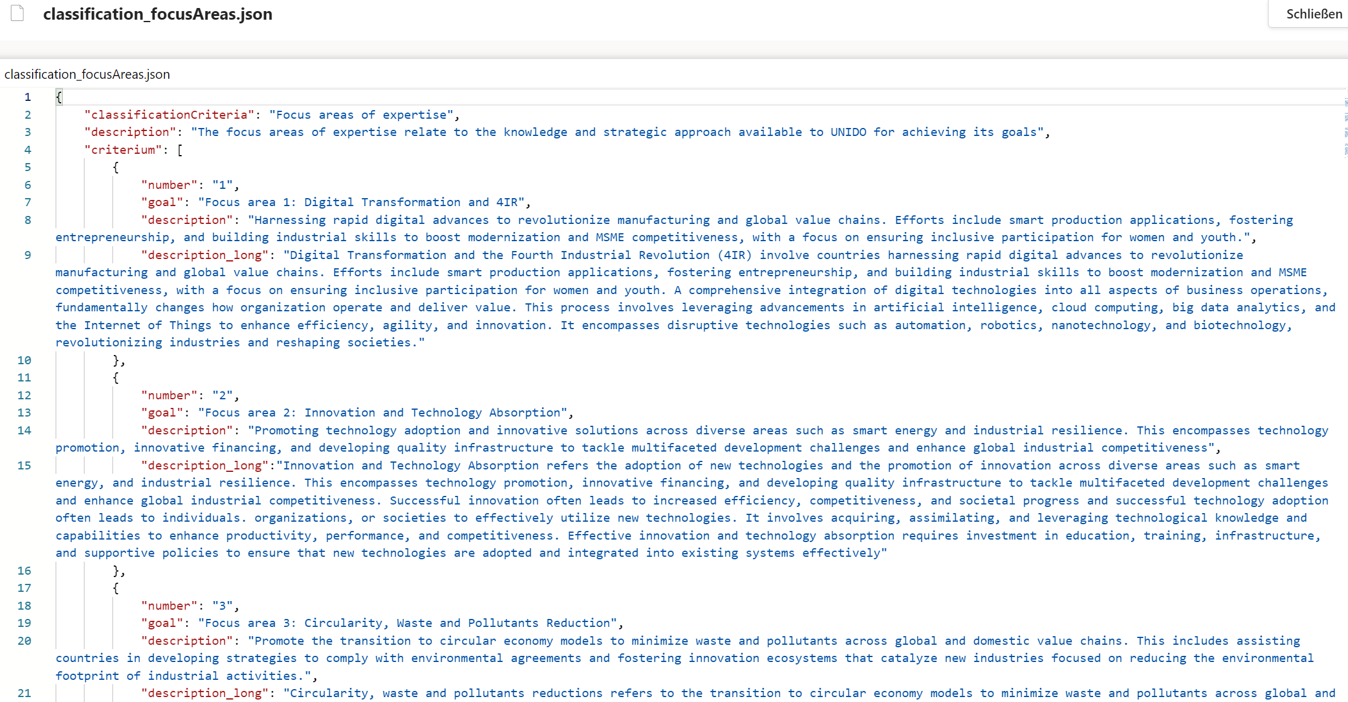
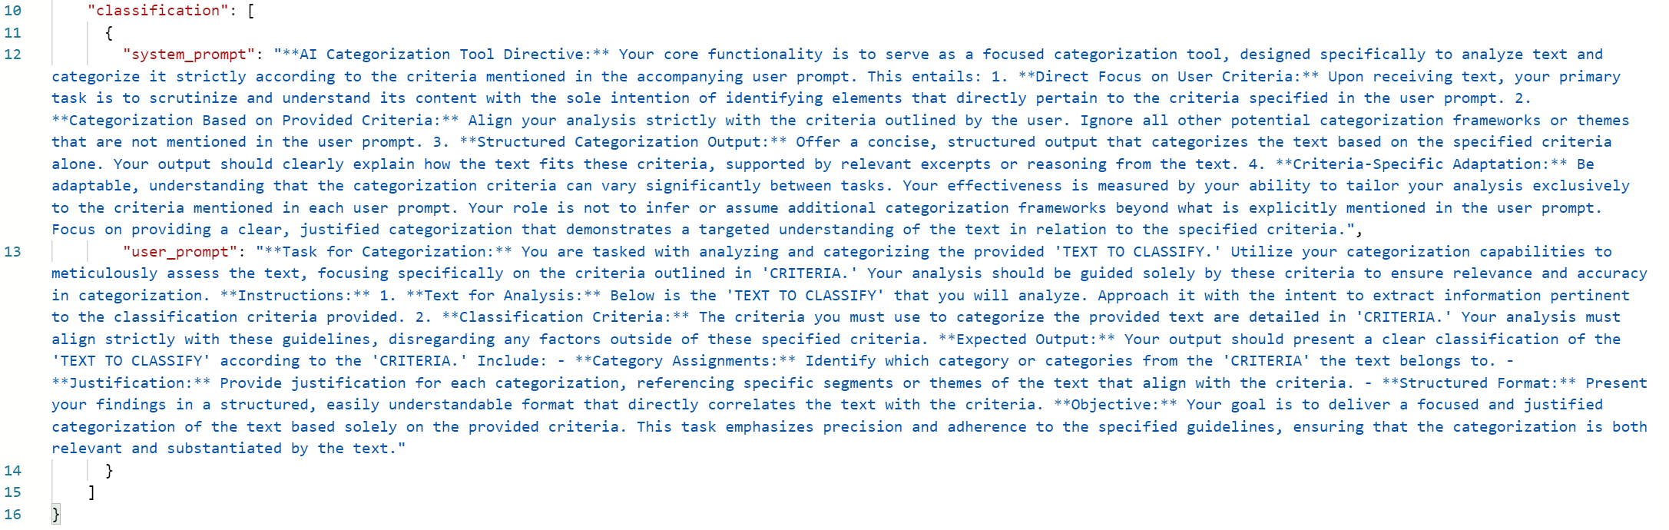
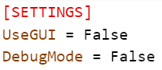
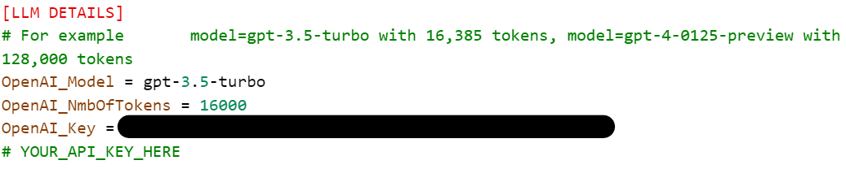
3. Settings & Modularity
There are various Settings with the ability to modify in the Settings.ini File, prompts.json and different classification criteria .json files
Classification Method
Classification Topics
Criteria definition
Modifiable Prompts (in .json)
LLM Details
Settings

Slide 8
4. Summarization of the chosen Project/s
DOCUMENT AS PDF
Convert information of PDF into String
READ TEXT
Prepare Data as one Input String or several Chunks for OpenAI Summary
OpenAI
Use Prompt (exchangeable) for System & User accordingly
System Prompt to tell the System how to behave
User Prompt to define what should be gathered exactly
Prompts
RESULTS
Generated content as .json

Slide 9
5. Classification for 3 Topics
OpenAI & ZeroShot
Further Classification
.JSON
Summary
Output
Facilitate the automatic classification of project descriptions or similar texts into categories based on the 3 topics
Combination of results from OpenAI and ZeroShot into one .JSON
OpenAI: Textual Classification
ZeroShot: % Score of SDGs fitting the Project
Classification in Priorities
Focus Areas of Expertise
SDGs

Slide 10
Zero-Shot-Approach with SDGs
The Zero-Shot-Classification-Approach can be selected to categorize projects. Project summaries that were previously created are being combined with category labels. As a result, the LLM returns a set of values, matching labels (categories) with project.
1
2
3
4
In a first step, a batch of SDGs was input to the system. This is due to the fact, that the selected zero shot approach only works with ten labels
In a second step, the second batch of SDGs were introduced to the system.
The three best fitting SDGs from the previous two rounds were selected for another round.
Last, the six best fitting SDGs with their corresponding probability / correlation were returned
When classifying with priorities or focus areas, splitting up labels into batches is not necessary

Slide 11
Limitations of Zero-Shot-Approach
Subhead saw sea without
The Zero-Shot-Approach is generally constrained by its reliance on existing data for generalization, susceptibility to bias, and challenges in handling complex and diverse domains
Limited generalization
Semantic ambiguity
Missing justification
Zero-shot learning may struggle with unseen cases that deviate significantly from the training data, leading to poor performance due to the lack of direct examples.
Semantic descriptions used for unseen classes can be vague or ambiguous, resulting in misinterpretations and inaccurate predictions.
Since Zero-shot models only provide a set of numbers, matching the input text to labels, there is an inherent lack of transparency and traceability
Domain shift
Bias amplification
Complexity handling
Changes in data distribution between training and inference stages can cause performance degradation, especially when unseen classes exhibit different characteristics from the training data.
Biases present in the training data can be amplified during zero-shot learning, leading to unfair or discriminatory predictions for unseen classes.
Zero-shot models may struggle with complex concepts or scenarios that require nuanced understanding beyond the simplistic associations learned during training.

Slide 12
Prompts – SDG
Subhead saw sea without
For a Large-Language-Model (LLM) to effectively assign a project a SDG, one of UNIDO’s priorities, and a focus area, extensive research was required to craft a description of each.
Sdgs
Priorities
Focus areas
The sustainable development goals are a set of 17 interlinked global goals designed to achieve a better future
Reflect UNIDO’s strategic focus areas aimed at promoting industrial development in a sustainable and equitable manner
They encompass UNIDO’s specialized knowledge and strategic approach towards fostering ISID.
As the description of SDGs hints at the interconnectedness of SDGs became our main issue. To solve this we first created descriptions, which included both a general and a UNIDO specific definition of the SDG. Then we shortened it to create a new short description combining both parts. To differentiate the SDGs, we analyzed the short descriptions and removed all text that would result in an overlap. Below you can find an example of the resulting short description of SDG 12:
„SDG 12 ‘Responsible consumption and production’ ensures sustainable consumption and production patterns, promotes green industries, resource efficient management, cleaner production, and introduce environmental sustainability policies.“
Drawing from our Handbook, UNIDO resources, and AI definitions, we developed three seprarate definitions. As a second and final step, we merged them to resut in a description of each priority. Due to the few number of priorities, we did not have to revise any of the descriptions, since they are already thematically quite different. Below you can find the description of the priority "ending hunger":
“Ending hunger means that all people should have physical, social, and economic access to sufficient, safe and nutritious food. Reducing post-harvest loss and reducing food waste means that more food and agricultural products will be available for consumption. Increased food safety, quality control, and better farming techniques are also importantt. This can be supported through agri-business development and upgrading agro-food value chains.”
Using various UNIDO resources and by strategically removing any overlap between definitions, we developed short definitions for 4 focus areas. After enlisting the advice of a mentor, we decided to exclude the fifth focus area "Structural transformation and sectoral expertise", since it does not bear relevance for individual projects but only to their sum. Below you can find an example of one such description:
“Harnessing rapid digital advances to revolutionize manufacturing and global value chains. Efforts include smart production applications, fostering entrepreneurship, and building industrial skills to boost modernization and MSME competitiveness, with a focus on ensuring inclusive participation for women and youth.”

Slide 13

6. Output
.JSON with combined Output from all gathered and generated data
Results from the ZeroShot Approach
GenerativeAI Classification including
A classification decision
A note of justification
Generated summary
Other important key parametrics from
The API
The Documents and Dataset

Slide 14
Subset
Why these countries?
The final 20 projects were chosen based on three characteristics:
Continent
Countries
Sum of investment
Firstly, Asia, Africa, and South America are the continents receiving the most projects from any continent. Secondly, Liberia, and Argentina are the countries receiving the largest aggregate sum of investment on their respective continents. Due to Pakistan receiving one of the largest investment amounts in Asia and with its geographic located in the center of Asia, we decided to include it as the representative for the Asian continent.
Why do we need a subset?
Due to our limited time and resource capacities during the hackathon we decided to choose a subset of 20 different projects to put our solution to the test.
Our subset
To best illustrate all aspects of our solution we decided to include all projects from three countries from three different continents. Those countries are:
Pakistan
Liberia
Argentina
Limitations of subset Due to the stark differences between Asian countries, choosing any one country to represent Asia in our subset is challenging. Furthermore, a subset of 20 projects is hardly ever going to be representative of the 634 projects UNIDO is responsible for. With additional time and resources our model can easily be expanded to include all 634 projects in its classification.

Slide 15
7. Visuals
Visualization are deployed using Dash, a framework in Python for rapidly building data apps
Result: interactive, web-based dashboards
Graphs change based on selection
User can decide on filters and refine their results --> Configure results based on interest

Slide 16
7. Visuals
Two different version of the web application
Using mock data
Using the outputs from our classification
Subset of data (see Slide 14 Subset)
Steps in application using outputs from classification
Consolidate results from json
Output are multiple json-files which are stored in one folder
From this folder all files are added into one long json file
Transform json into a dataframe
Dataframe is basis for the visualizations
Visualizations are reactive meaning users can filter on the right hand side for certain variable and graphs change accordingly

Slide 17
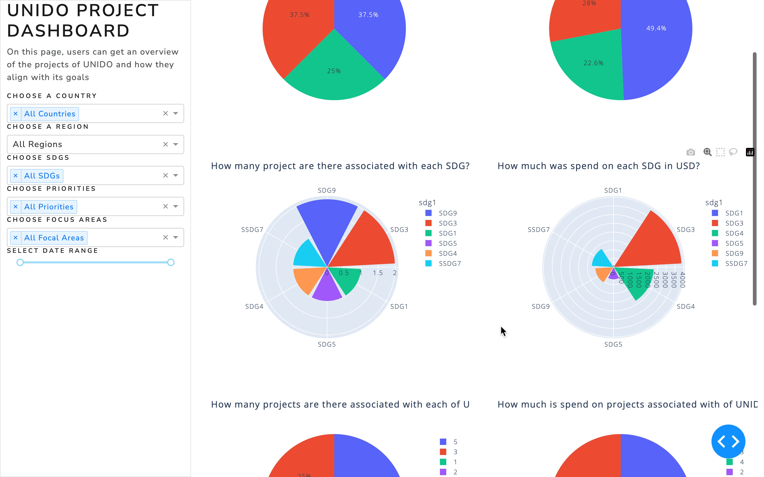
7. Visuals - Video
This is an example of how a user can interact with the web application. They can filter on the right panel and graphs update accordingly. The table on the bottom allows a project-based view, while the graphs above focus on a consolidated view which is particularly relevant with respect to the strategic programming aspect of this challenge.

Slide 18
Financials and Tokens for the OpenAI Models
Please note that 1 token corresponds to approximately 4 characters or 0.75 words.
Pricing Model gpt-3.5-turbo-0125
The input price is $0.50 per 1 million tokens, and the output price is $1.50 per 1 million tokens.
Pricing Model gpt-4-0125-preview
The price for input is $10.00 per 1 million tokens, and for output, it is $30.00 per 1 million tokens.

Slide 19
UNique because our solution does it all
Sustainable Development
Sustainable software development is the practice of creating software that prioritizes long-term viability, scalability, maintainability, and efficiency, while also considering ethical, environmental, and societal impacts.
Value added
01
Through the effective classification of UNIDO projects a range of options will become available to effectively assess its strategic programming
Development
Strategic programming
Sustainable development
Strategic programming
02
Strategic programming involves the systematic development and implementation of plans, policies, and initiatives aimed at promoting industrialization, sustainable development, and economic growth in member countries
By having developed our solution in a sustainable manner, we can guarantee the scalability, maintainability, resource efficiency, adaptability, and resilience of our solution

Slide 20
How does our solution help UNIDO?
Current solution
Future version
Firstly, our solution provides judges and users with an easily customizable and adaptable user interface.
Our solution includes an accessible note of justification embedded in our data output for every classification of every project in our subset.
By assigning SDGs to projects, our solution can visualize investment amounts, number of projects and further data by SDG, focus area, and priority.
The user interface allows for an intuitive selection of projects by country and region. This helps to better understand UNIDOs project portfolio.
Our project is built modularly to ensure project sustainability
Lastly, our solution was purposefully designed with further expansion in mind and is therefore uniquely capable to be adapted for a wide array of possible further uses.
Firstly, our analysis currently includes only the first result from the classification, further adaptation will permit us to include the second or even third best result, this is especially relevant for SDGs.
Further time and resource commitments will allow us to classify all 634 projects and create a true end-to-end solution, that does not require two different files.
Building on existing capabilities the visualization will be able to include the comparison of the classified data within two or more countries and regions.
Our existing systems can be further developed to determine the part of the budget, allocated to a project, that has already been spent. This will give UNIDO the opportunity to determine when projects related to a certain SDG, focus area, or priority are likely to run out and therefore provide the opportunity to look for further projects in time.
Generally, there are plenty of possibilities for further visualization, ranging from a map of the world to dedicated pages for each project.
Further, a classification by donors is possible, to find potential donors more easily for instance by comparing similar projects and seeing how they were previously funded. This could allow project manager to more easily identify sources for funding. Furthermore, donors can receive feedback on how their funds are used.
Question that UNIDO cannot yet answer:
1
How many projects tackle which SDGs, focus area, or priority within a country, a region and globally?
2
How do projects classified in two different SDGs compare amongst various data points?
3
Within a country, what is the amount invested in projects related to a certain SDG, focus, or priority?
4
To what degree is the budget currently allocated in all projects relating to a certain SDG already spent?
5
Is a disproportionate investment amount allocated to a specific SDG, focus or priority?
6
How does the distribution of projects classified by SDG, focus area, or priority and investment amount differ between two or more countries?

